Slide 1
Dec 14-13
CySwap

Slide 2
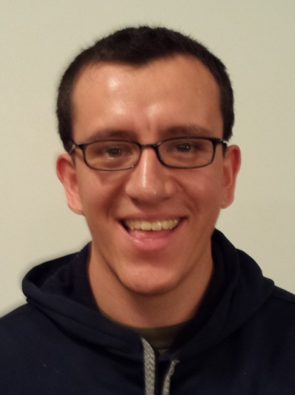
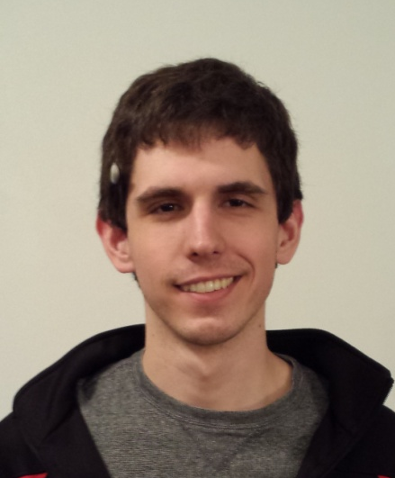
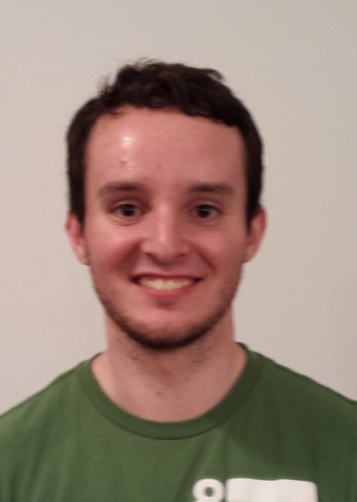
Team Information
Client: Merry Rankin, Office of Sustainability Michael Hoefer, GSB
Adviser: Professor Mitra
Kyle Johnson
Team Leader
Fabian Briesmoore
Key Idea Holder
Jared Cook
Webmaster
Adam Sunderman
Communicator
Dec 14-13
Notes:
Kyle

Slide 3
Problem Statement
The Government of the Student Body is aiming to develop a website that allows Iowa State Students to buy and sell goods. The site will allow for multiple types of items to be sold. The site will not handle the monetary transaction between students. It should instead be a way of connecting students.
Dec 14-13
Notes:
Fabian

Slide 4
Major Functional Requirements
Post an item to sell
Contact a seller
Reporting
Content Management
Course Information from the Bookstore
NetID Authentication
Textbook information lookup from ISBN
Dec 14-13
Notes:
Jared. Discuss iterative requirements gathering phase.

Slide 5
Major Non-Functional Requirements
Site Traffic handling- 30,000 Students
Security- Database and User Sessions
Expandability- New categories
Maintainability- Goal of Client never needing to look at code.
Dec 14-13
Notes:
Adam

Slide 6
Risks
Risk | Mitigation
Interpreting data from the Bookstore’s database dump. | Administrator function to turn off pulling information from the Bookstore.
Large amount of site traffic. | Stress testing on the site using LoadImpact and LoadUIWeb.
Developing the system with a technology we have little experience with. | Chose a technology with a large amount of documentation and popularity.
Concurrency handling. | Researching Laravel down()/up() features.
Dec 14-13
Notes:
Kyle

Slide 7
Schedule
Product Releases
Version 1: 06/23/14
Version 2: 10/17/14
Version 3: 12/12/14
Dec 14-13
Notes:
Fabian

Slide 8
Technologies
Product:
Laravel/PHP
Html/Css/Bootstrap
MySQL
LAMP Server
Development:
Jira
MySQL Workbench
WAMP Server
Github
Dec 14-13
Notes:
Jared: Discuss how these technologies were chosen
Kyle: Development methodology

Slide 9
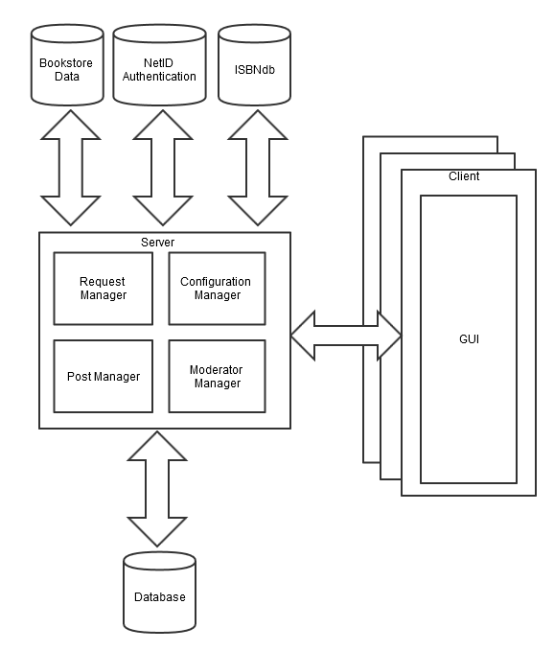
System Block Diagram
Dec 14-13
Notes:
Adam: Model View Controller

Slide 10
Demo
Home Page
Category Pages
View an Item
Post an Item
Login
Dec 14-13
Notes:
Jared

Slide 11
Plan for Summer and Fall
Continue to work a few hours each week over the summer.
Summer Version 1 release
2nd and 3rd Iterations in the fall.
Dec 14-13
Notes:
Fabian

Slide 12
Questions?
Dec 14-13

