Slide 1
CySwap
Team Dec 14-13
Kyle Johnson Adam Sunderman Jared Cook Fabian Briesmoore Jake Roman

Slide 2
Problem Statement
The Government of the Student Body wanted a website with the following features:
Setting up transactions between students to buy and sell items
Selling multiple types of items
Doesn’t handle money; simply sets up a connection between students wanting to trade

Slide 3
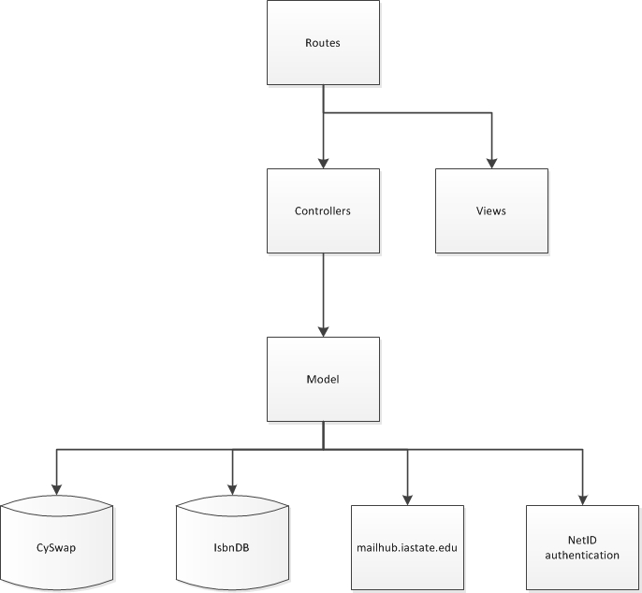
View post blade template
Design Process
Model View Controller Pattern
Controller communication between model and blades
Iterative Development Model
Requirements
Design
Testing
Evaluation
PostController.getPost($postid)
Post.getPost($postid)
MySQL Select

Slide 4
Development Process
Jira -> Tasks to be developed (student licensing)
Local Solution -> Develop the solution
DevLocker -> Test the solution in a production-like environment
Staging -> Regression and Integration Testing

Slide 5
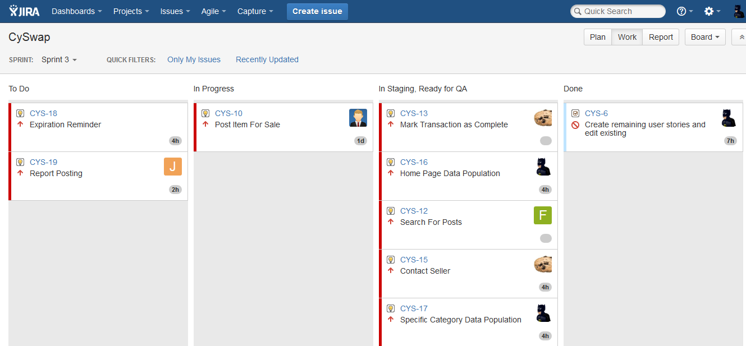
JIRA workflow

Slide 6
Technologies/Resources
Product:
Laravel/PHP
Html/Css/Bootstrap
MySQL
LAMP Server
Development:
Jira
MySQL Workbench
WAMP Server
Github

Slide 7
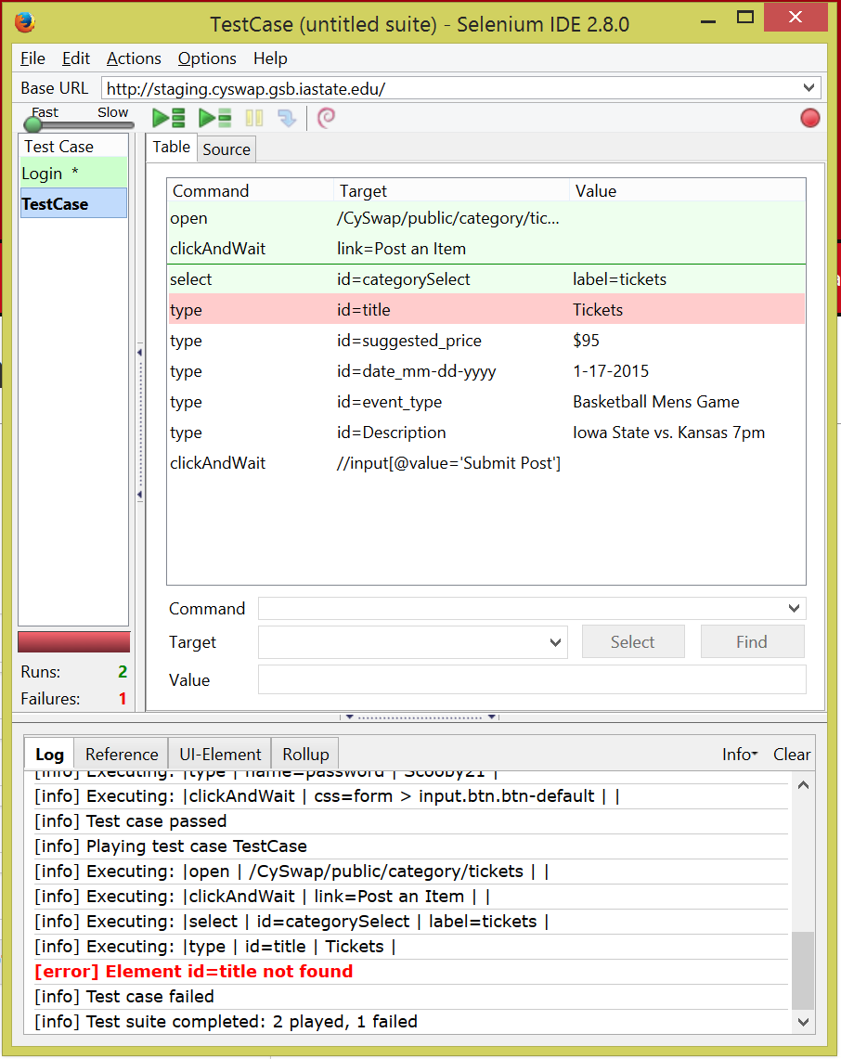
Debugging and Testing Plan
Debugging
Server feedback
var_dump
Laravel API Documentation
Testing
Acceptance Tests
Selenium Testing

Slide 8
Technical Challenges
Search for Post
Content Management
Adding and Removing Categories
Report Handling

Slide 9
Questions?

